Slide 1
Introduction to Statistical Investigations
Second Edition
Tintle, Chance, Cobb, Rossman, Roy, Swanson, VanderStoep
Chapter 1
Significance: How Strong is the Evidence?
This slide deck contains animations. Please disable animations if they cause issues with your device.
Copyright ©2021 John Wiley & Sons, Inc.

Slide 2
Definitions so far
Sample (space): The values we observe and write down.
Example: Harley the dog chooses the right cup or the wrong cup.
Sample size: The number of observational units.
Example: Harley has 2 choices (right/wrong cup).
Statistic: A number computed to summarize the variable we measured on a sample.
Example: Harley the dog chose the correct cup 9 times out of 10, so 9/10.
NEW! Parameter: A long-run numerical property of the process. Long-run proportion

Slide 3
Definitions so far
Chance model: using a random process to model the situation.
3S strategy:
Statistic: a number that we observe from the data.
Simulate: Write up what a "by-chance" model would give us. Repeatedly conduct the experiment, and see how our observed statistic compares.
Strength of evidence:
Determine if the observed statistic is unlikely/likely to have occurred from the chance model.

Slide 4
Section 1.2: Measuring Strength of Evidence
In the previous section we performed tests of significance.
In this section we will make things slightly more complicated, formalize the process, and define new terminology.

Slide 5
Example 1.2: Rock-Paper-Scissors (1 of 2)
Rock-Paper-Scissors Rules
Rock smashes scissors
Paper covers rock
Scissors cut paper
Are these choices used in equal proportions

Slide 6
Example 1.2: Rock-Paper-Scissors (2 of 2)
One study suggests, among novice players, that scissors are chosen less than of the time.
Suppose we are going to test this with a friend (who hasn’t played before) by playing 20 games against you.
What are the observational units?
What is the variable?

Slide 7
Example 1.2: Rock-Paper-Scissors
Even though there are three outcomes, we are focusing on whether the player chooses scissors or not. This is called a binary variable because we are focusing on two outcomes (both not necessarily equally likely).

Slide 8
Example 1.2: Terminology: Hypotheses
When conducting a test of significance, one of the first things we do is state the null and alternative hypotheses.
The null hypothesis is the chance explanation.
Typically the alternative hypothesis is what the researchers think is true.

Slide 9
Example 1.2: Null vs. Alternative Hypotheses

Slide 10
Example 1.2: Hypotheses from Buzz and Doris
Null Hypothesis: Buzz will randomly choose a button. (He chooses the correct button 50% of the time, in the long run.)
Alternative Hypothesis: Buzz understands what Doris is communicating to him. (He chooses the correct button more than 50% of the time, in the long run.)
These hypotheses represent the parameter (long run behavior) not the statistic (the observed results).

Slide 11
Example 1.2: Hypotheses for Rock Paper Scissors using Words
Null Hypothesis: People playing Rock-Paper-Scissors will equally choose between the three options. (In particular, they will choose scissors one-third of the time, in the long run.)
Alternative Hypothesis: People playing Rock-Paper-Scissors will choose scissors less than one-third of the time, in the long run.
Note the differences (and similarities) between these hypotheses and the hypotheses for Buzz and Doris.

Slide 12
Example 1.2: Hypotheses for Rock Paper Scissors using Symbols
where π is players’ true probability of throwing scissors

Slide 13

Example 1.2: Setting Up a Chance Model
Because the Buzz and Doris example had a 50% chance outcome, we could use a coin to model the outcome from one trial.
What could we use in the case of Rock-Paper-Scissors?

Slide 14
Example 1.2: Three S Strategy
Statistic: Compute the statistic from the observed data. [In 20 games, scissors was chosen 4 times. This sample proportion can be described using the symbol
Simulate: Identify a model that represents a chance explanation. Repeatedly simulate values of the statistic that could have happened when the chance model is true and form a distribution.
Strength of evidence: Consider whether the value of the observed statistic is unlikely to occur when the chance model is true.
Notes:
Delete (2 of 2)

Slide 15
Example 1.2: Applet
We will use the One Proportion applet for our test.
This is the same applet we used last time except now we will change the probability under the null hypothesis.
Let’s go to the applet and run the test. (Notice the use of symbols in the applet and how they change when we change 0.50 to 0.3333.)

Slide 16
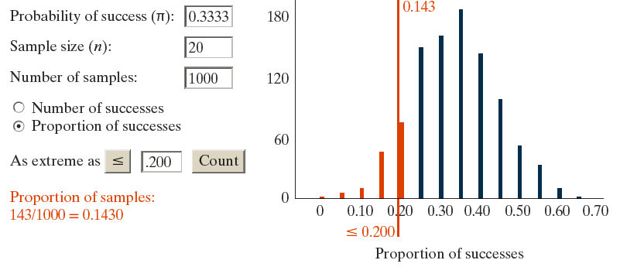
Example 1.2: Null Distribution
The null distribution is the distribution of simulated statistics that could have happened in the study assuming the null hypothesis was true.

Slide 17
Example 1.2: p-value
The p-value is the proportion of the simulated statistics in the null distribution that are at least as extreme (in the direction of the alternative hypothesis) as the value of the statistic actually observed in the research study.
We should have seen something similar to this in the applet:
Proportion of samples:

Slide 18
Example 1.2: What Can We Conclude? (1 of 2)
Do we have strong evidence that less than
of the time scissors is thrown?
How small of a p-value would you say gives strong evidence?
Remember: the smaller the p-value, the stronger the evidence against the null.

Slide 19
Example 1.2: Guidelines for Evaluating Strength of Evidence from p-values
p-value > 0.10, not much evidence against null hypothesis
0.05 < p-value ≤ 0.10, moderate evidence against the null hypothesis
0.01 < p-value ≤ 0.05, strong evidence against the null hypothesis
p-value ≤ 0.01, very strong evidence against the null hypothesis

Slide 20
Example 1.2: What Can We Conclude? (2 of 2)
So we do not have strong evidence that fewer than
of the time scissors is thrown.
Does this mean we can conclude that
of the time scissors is thrown?
Is it plausible that
of the time scissors is thrown?
Are other values plausible? Which ones?
What could we do to have a better chance of getting strong evidence for our alternative hypothesis?

Slide 21
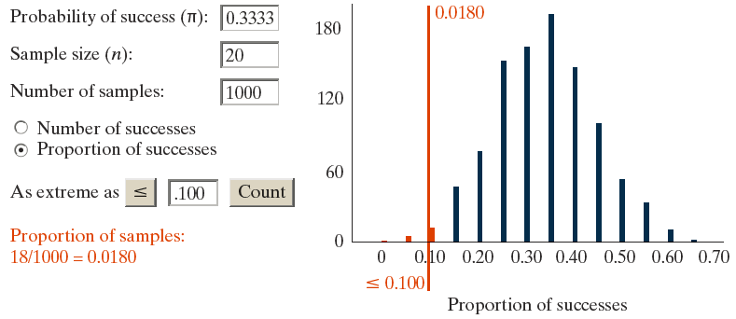
Example 1.2: Rock Paper Scissors Redo
What if only 2 out of 20 times (10%) scissors was played? How would this change the p-value?
Values of the statistic that are even farther from the hypothesized parameter give smaller p-values and stronger evidence against the null.

Slide 22
Example 1.2: Summary (1 of 2)
The null hypothesis (H₀) is the chance explanation. (=)
The alternative hypothesis (H_{a}) is what you are trying to show is true. (< or >)
A null distribution is the distribution of simulated statistics that represent the chance outcome.
The p-value is the proportion of the simulated statistics in the null distribution that are at least as extreme as the value of the observed statistic.

Slide 23
Example 1.2: Summary (2 of 2)
The smaller the p-value, the stronger the evidence against the null.
p-values less than 0.01 provide strong evidence against the null.
π represents the population parameter
represents the sample proportion
n represents the sample size

Slide 24
Learning Objectives for Section 1.2 (1 of 2)
Use appropriate symbols for parameter and statistic.
State the null and the alternative hypotheses in words and in terms of the symbol π, the long-run proportion.
Explain how to conduct a simulation using a null hypothesis probability that is not 50-50.
Use the One Proportion applet to obtain the p-value after carrying out an appropriate simulation.

